Slide 1


Force training ltd
Adrian Buksinski

Slide 2
Introduction
Previous experience
Overview and Approach to project .

Slide 3
What Have I Learned
App Building and Customization
Process Automation using Flows and Process Builder
Security
Apex and Visualforce

Slide 4

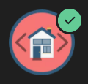







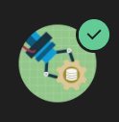
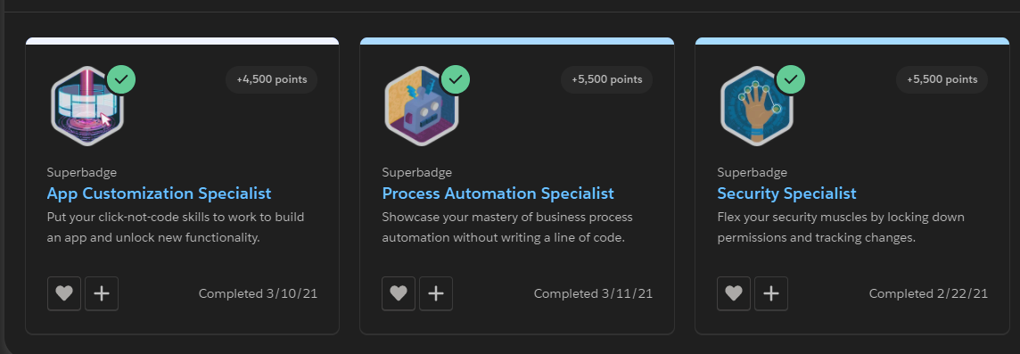
Trailhead
Practice

Slide 5
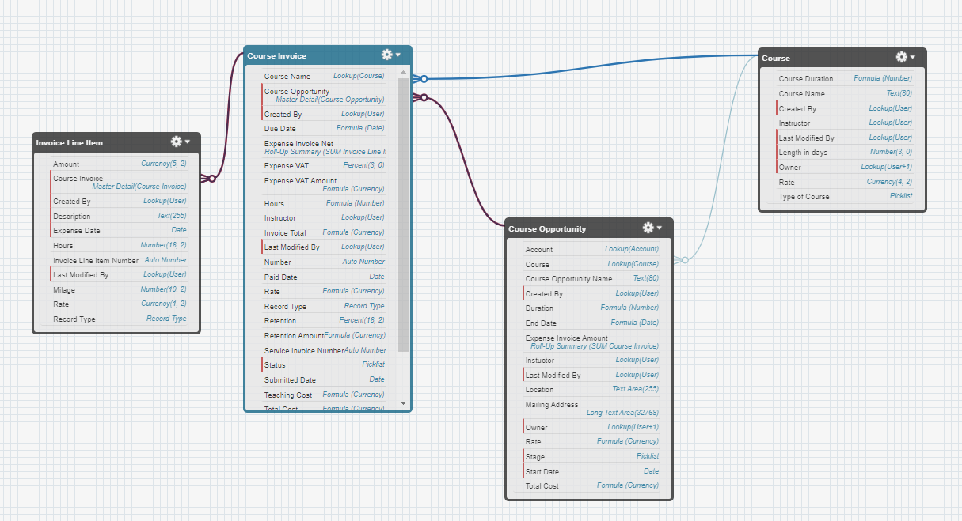
Schema Builder

Slide 6
Demonstration

Slide 7
Conclusions
What Went Well | What could be improved
Creating new Org | Modifying an Access for different users
Creating custom objects and relationships between them | Auto Numbering Invoices depending on its type.
Validation Rules | Sending Email with PDF attached to Billing Administrator
Creating Records | Service Line Items instead of Formulas
Generating PDF | Style of PDF
Sending Notification | Reports and Dashboards
 | Tests
 | Org functionality needs a lot of polishing

Slide 8
Questions

